Slide 1
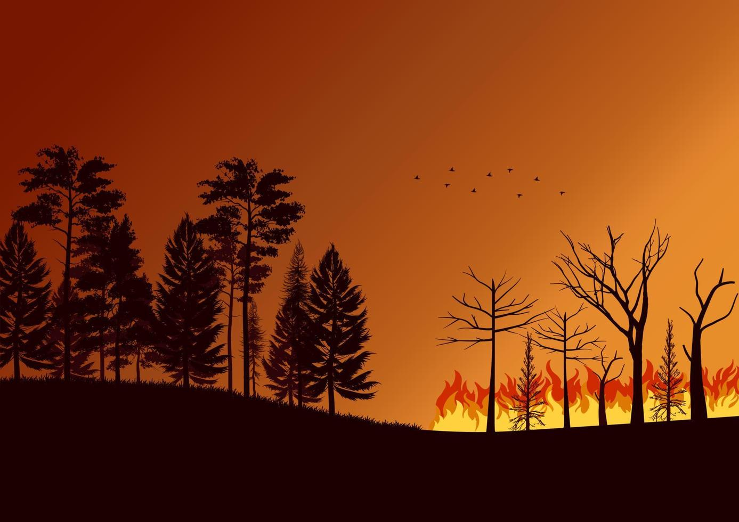
Forecasting Flames: Driving Impact with Spatio-Temporal ML
Anjali Pillai (ap66745)
Anita Yadav (ay7997)
Sam Song (sks3858)
Sushanth Ravichandran (sr56925)
Sneha Sastry Rayadurgam (sr56732)

Slide 2
Table of Contents
Fire and Introduction
Data Overview
Base Models
Drawbacks from Base Models
Main Models
Business Value
Conclusion

Slide 3
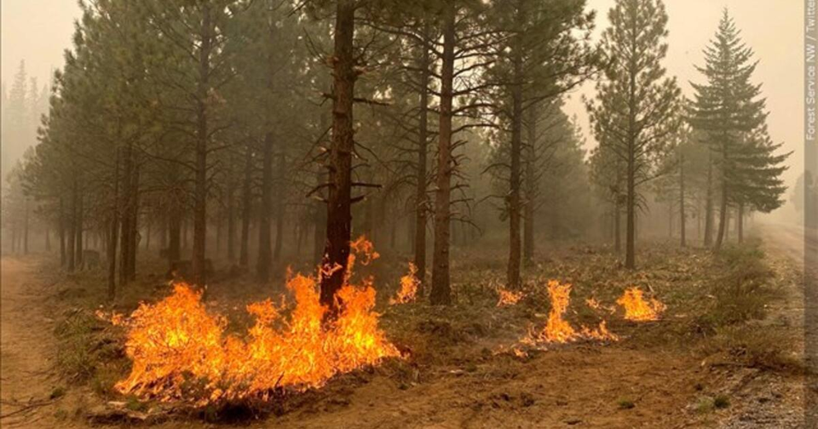
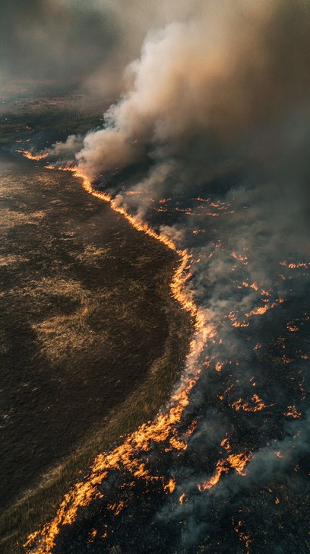
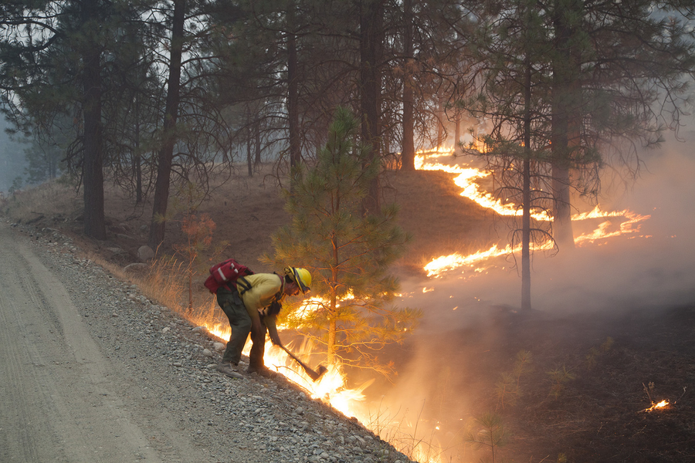
Introduction
Fire Line:
Boundary where a wildfire meets unburned vegetation
The Challenge in predicting fire line:
Unpredictable and destructive nature of wildfire
Dependence on terrain, wind, fuel, and environmental conditions
Notes:
This is the intro Business Context

Slide 4
Business Context
Economic Cost of Wildfires in the U.S.: $394B–$893B annually
Insurance: Improves pricing accuracy, reduces losses
Utility Companies: Helps manage power lines, reduce liabilities
Emergency Response: Optimizes firefighting resource deployment
FLAME AI Challenge: Drives innovation, minimizes losses, and protects communities.
Notes:
This is the intro Business Context
Insurance: Predicting wildfire spread enhances policy pricing accuracy and reduces financial losses.
Utility Companies: Helps utilities manage power lines and reduce wildfire liabilities.
Emergency Response: Optimizes deployment of firefighting resources to minimize risks and damage.
FLAME AI Challenge - Not just an academic challenge—drives business innovation, minimizes financial losses, and protects communities and ecosystems.

Slide 5


Objective
The FLAME AI Challenge:
Use 5 consecutive timestamps of data, to predict the propagation of fire line for the next 20 timestamps
For this competition, we are working with a smaller dataset derived from Google Research’s FireBench project, dealing with a lot more data and a lot more parameters. We start simple!
Google FireBench
Notes:
To predict WildFire propagation using different environmental interactions by building an autoregressive spatio-temporal ML model

Slide 6
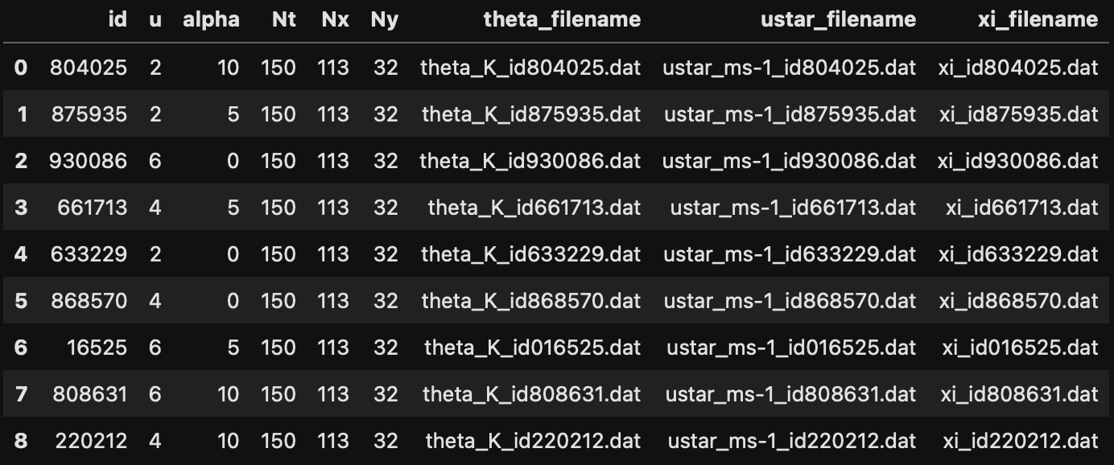
Data Overview
Metadata file:
id: contains the unique id representing the fire
u and alpha: Global variables u for wind velocity and alpha for terrain slope for a given fire
Nt (Temporal): Number of time snapshots
Nx, Ny (Spatial): Grid size (height and width)
ustar_filename: .dat file with wind velocity data
theta_filename: .dat file with temperature data
xi_filename: .dat file with fire location data (0/1)
Problem:
Use data from t to t+4, to predict xi from t+5
to t+24

Slide 7
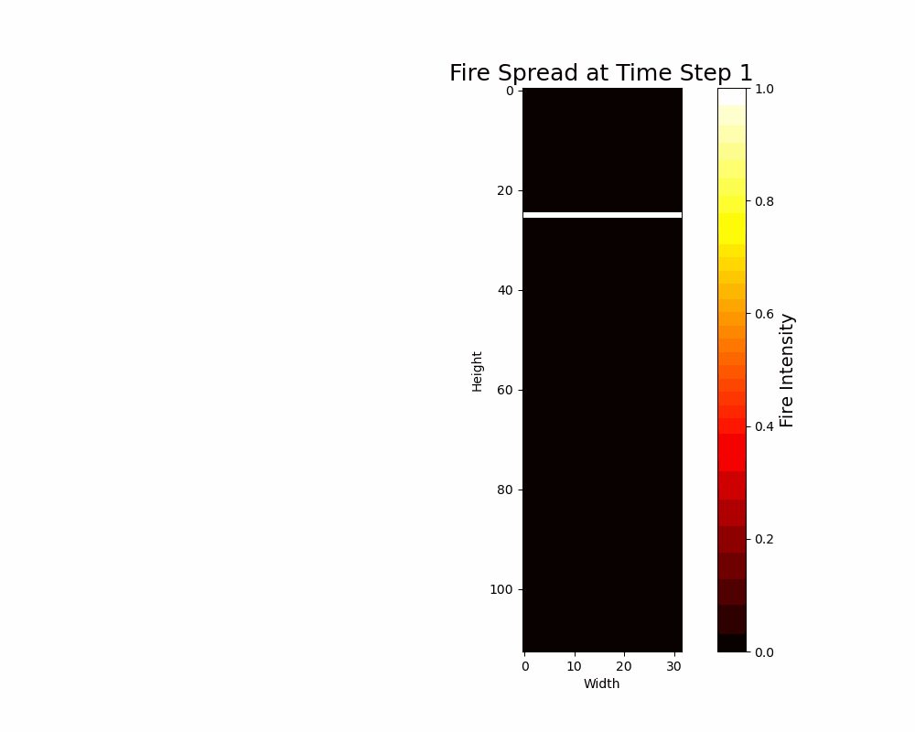
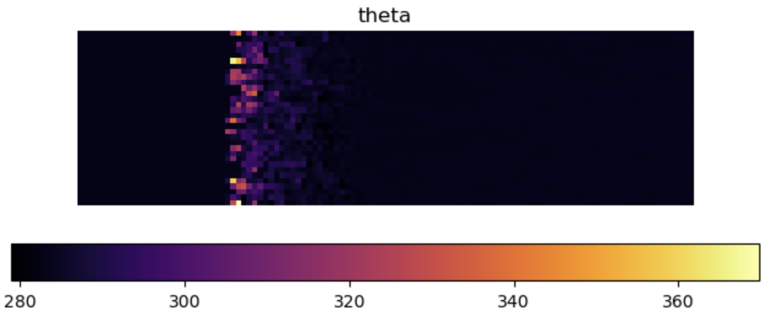
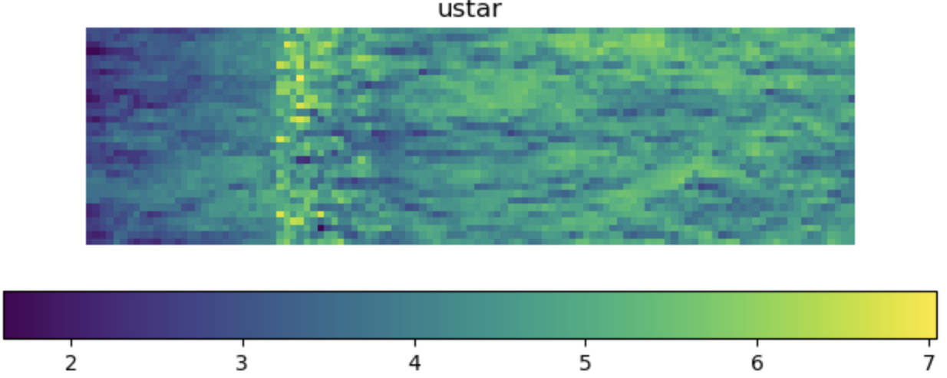
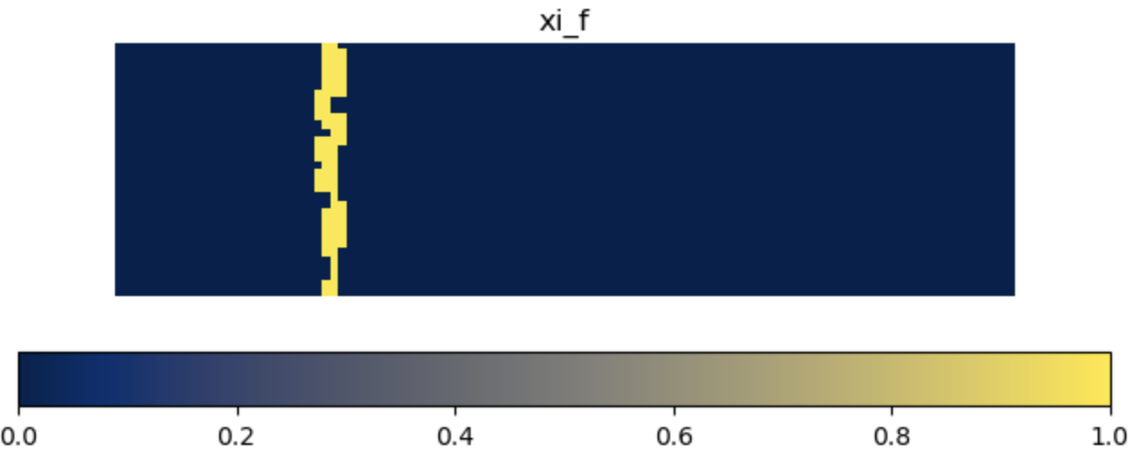

Visualizing the data
Fire propagation Visualization in our dataset

Slide 8
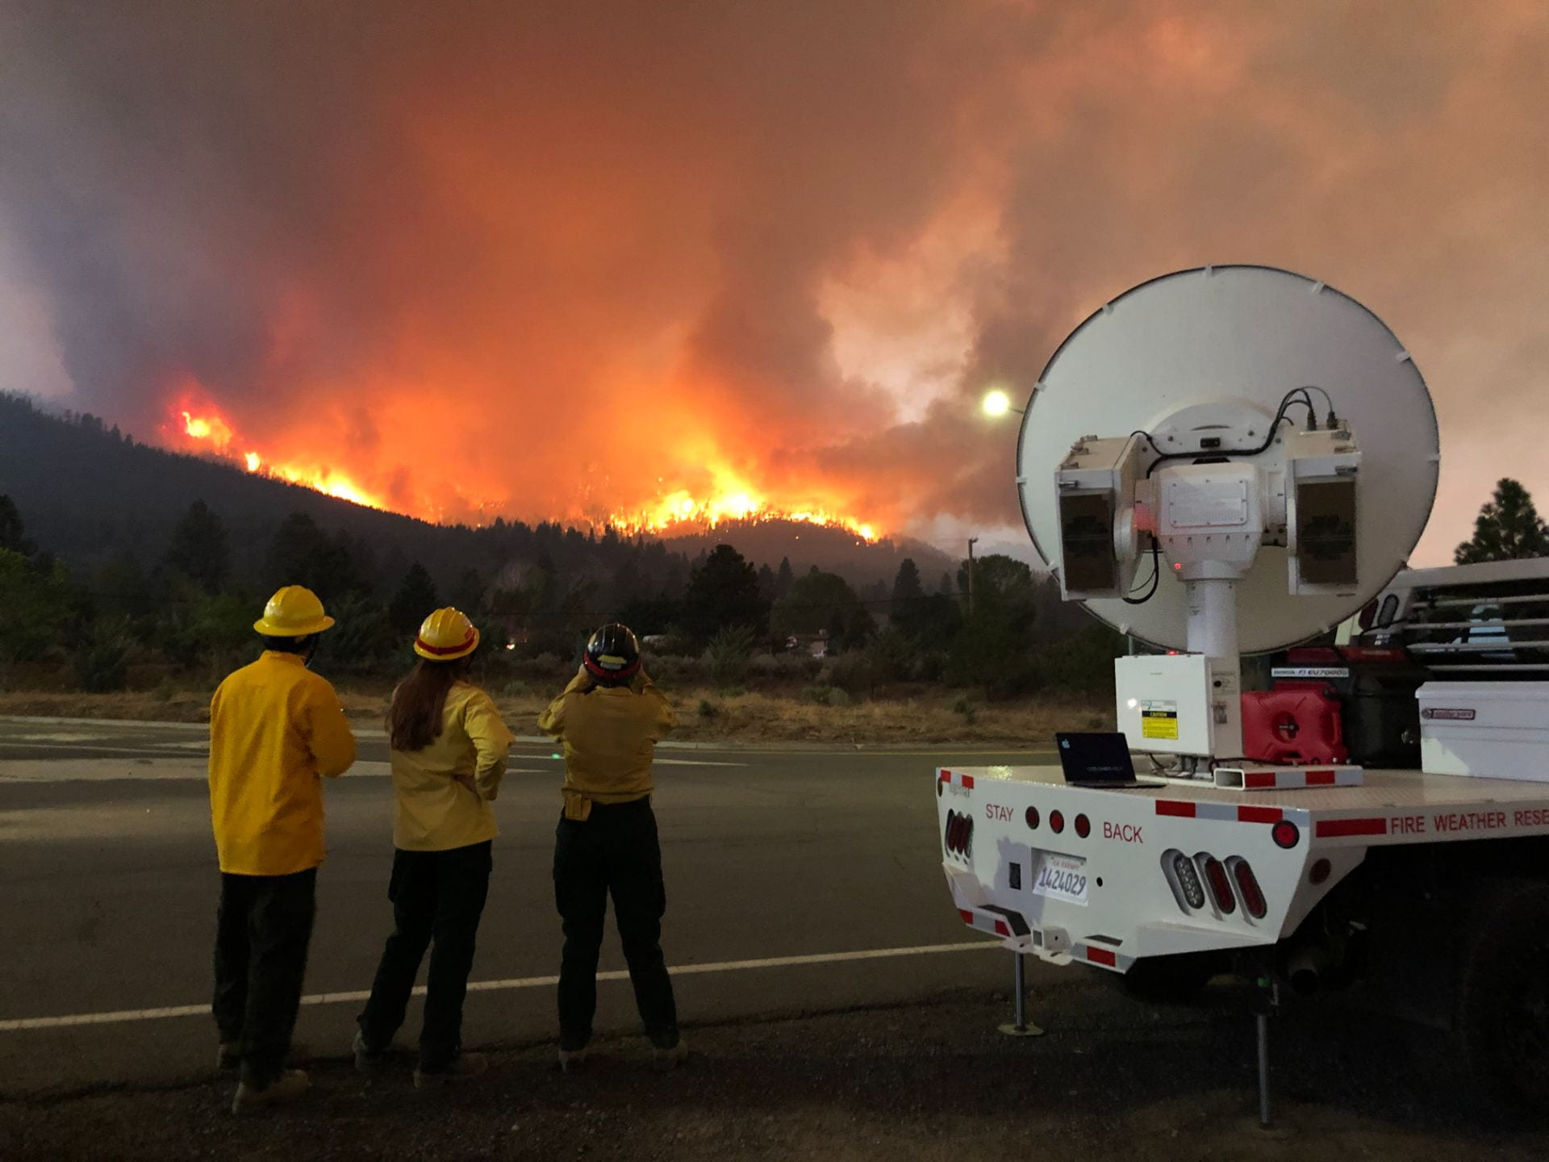
Our Models
Optical flow or Motion Flow
XGBoost
Conv NN + LSTM
Transformer

Slide 9
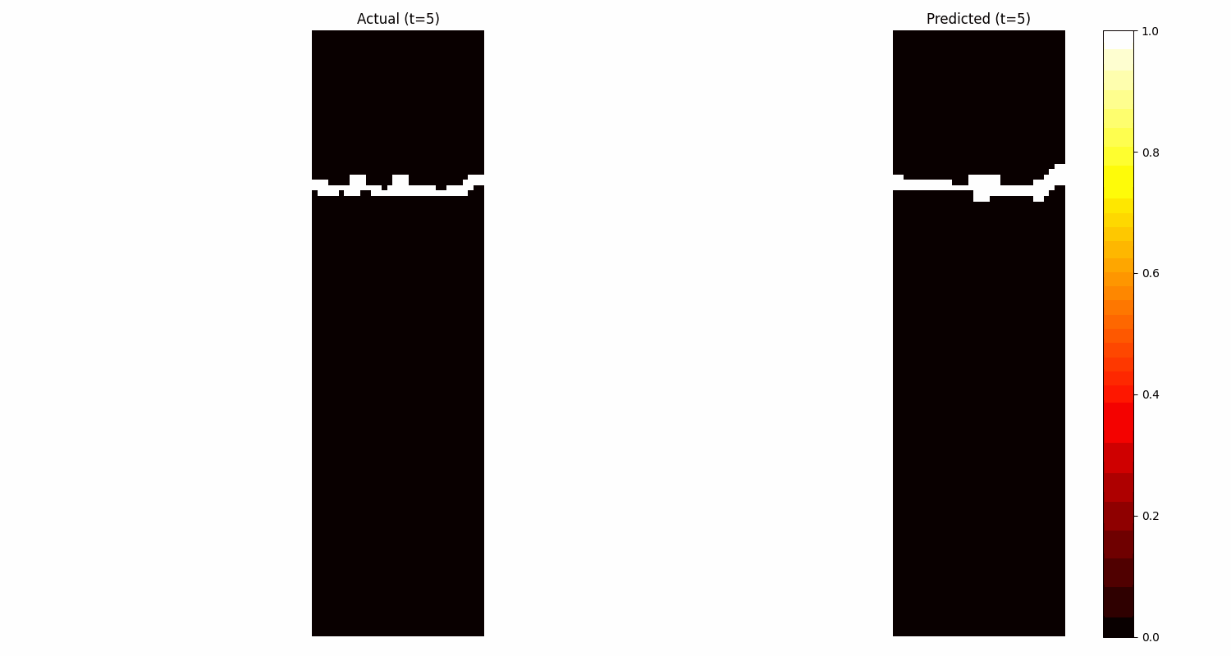
Optical Flow or Motion flow
Motivation to try:
Prof. Ghosh
Flow problem at the core
Observations:
Predicted line close to actual one but movement is too slow
MSE is still good because we are able to predict the background almost perfectly
While optical flow is valuable for short-term, localized motion estimation, it lacks the capacity to address the complex and long-term nature of wildfire spread.
Motivation to move to the next model:
Need to use the complete information to predict better
It does not inherently capture global temporal dynamics or long-term dependencies.
MSE for 20 timestamps = 0.034
Our benchmark. This is the number to beat
Notes:
Why Optical Flow May Not Be the Best Method
Local Focus Only:
Optical flow operates on frame-to-frame changes, ignoring global temporal dependencies and long-term patterns in wildfire spread.
Wildfires are influenced by global factors like wind, terrain, and fuel, which require a broader context.
Assumptions Break in Complex Data:
Relies on assumptions like brightness constancy and smooth motion, which fail in the presence of:
Rapidly changing fire dynamics.
Noisy data from sensors or incomplete observations.
No Predictive Power:
Optical flow is not inherently predictive—it estimates motion based on past frames without forecasting future changes.
Wildfire prediction requires a model that extrapolates future fireline movements, considering external factors (e.g., wind, terrain).
Does Not Use Multi-Modal Data:
Optical flow processes visual data but cannot integrate additional inputs like meteorological variables or fuel density.
Predictive models can leverage such multi-modal data to improve accuracy.
Computational Bottlenecks:
Dense optical flow methods are computationally expensive, especially for high-resolution grids, making them impractical for large-scale wildfire datasets.
Error Accumulation:
Iterative frame-by-frame motion estimation leads to compounding errors in long-term fireline tracking.
Predictive models handle longer time horizons more effectively.

Slide 10
XGBoost
Motivation to try:
Start with the simplest possible ensemble model.
Flatten inputs, predict one step at a time, and update inputs based on predictions
Accuracy:
Predicted fireline follows the general trend but lacks precision in dynamic changes.
Motivation to move to the next model:
Need to use the complete information to predict better
Lack of Spatial Awareness
Issue: XGBoost treats inputs independently, missing sequential dependencies.
Can only predict one time step at a time and iteratively updates for long-term forecasting.
MSE for 20 timestamps = 0.026

Slide 11
Transformer
Motivation to try:
Can process data parallely
Potential to capture a longer range of sequence better - can be combined with other models
Used positional encoding and spatial encoding to capture spatial and temporal relationships
Observations:
The predictions are static and did not change with time - the model was too simple
Motivation to move to the next model:
Too complex and does not capture the temporal relationship well with the existing architecture

Slide 12

Conv NN + LSTM
Motivation to try:
Capture temporal patterns through LSTM
Combine that with the spatial patterns captured by CNN with the temporal patterns hence captured
Added information through positional encoding
Observations:
The actual fire line is sharper than the predicted one but the overall bias reduces
Motivation to look ahead:
Explore the power of Mixture of models, data augmentation, dynamic thresholding

Slide 13
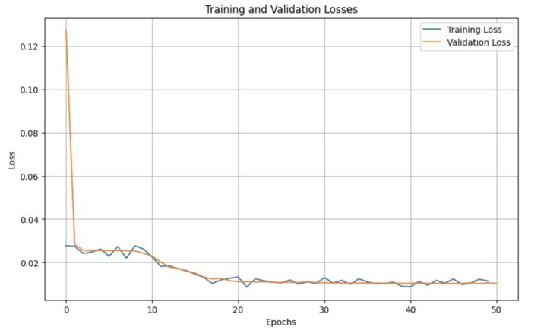
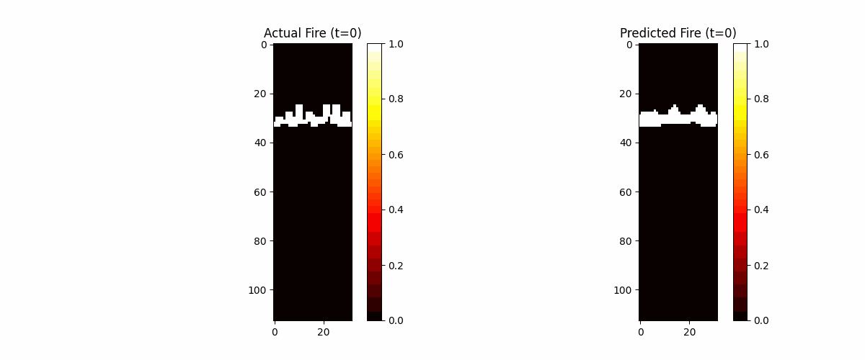
Conv NN + LSTM

Slide 14
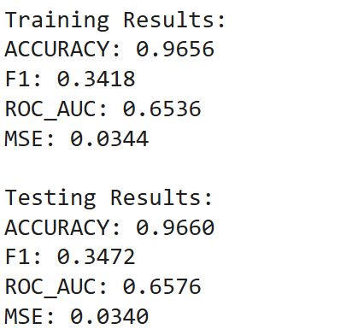
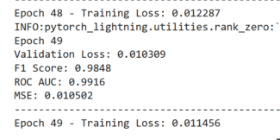
Results
Model | Optical Flow | XGBoost | Transformer | Conv NN + LSTM
MSE | 0.034 | 0.026 | 0.024 | 0.011
Optical Flow
Conv NN + LSTM
Notes:
Training Results - Optical Flow
Second box - Conv NN + LSTM

Slide 15
We also tried:
3D CNN - Computationally Expensive and Model Overfitting
Physics based NN - improper loss design and missing critical features like fuel properties, atmospheric effects, and radiative heat transfer.
ResNets - Overfitting of data, hyperparameters of dropout and regularization needs more tuning.
ST TN - Never got to optimise the network to improve the complexity

Slide 16
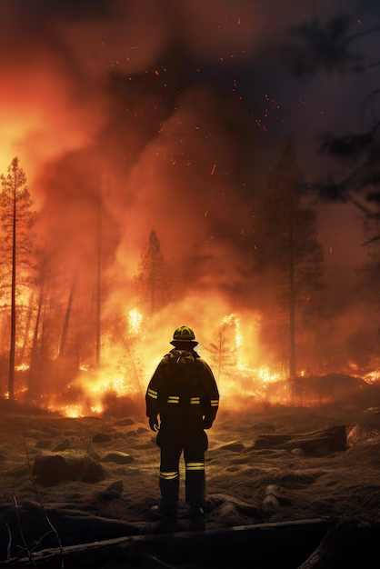
Business Value of Fire Forecasting
Refined Wildfire Response: Faster, smarter decisions with balanced accuracy and usability.
Risk Assessment: Enhanced predictions for better insurance pricing and minimized financial loss.
Utility Protection: Safeguards infrastructure, reducing wildfire liabilities.
Resource Optimization: Efficient deployment lowers risks and damages.
Notes:
Iterative modeling refines the balance between accuracy and usability, supporting faster, smarter wildfire response.
Enhanced Risk Assessment for Insurance - Improved wildfire predictions refine risk assessment and policy pricing, reducing financial losses.
Proactive Utility Management - Accurate forecasts help protect infrastructure and minimize wildfire liabilities.
Optimized Emergency Resource Deployment - Enables faster, smarter resource deployment to reduce risks and damage.

Slide 17

We had a lot of time but….
Here’s something
we have left -
“A Future Scope”
(for future)

Slide 18
Future Scope
Re-check the ST TN Architecture for higher complexity
Mixture of Experts : Combine specialized models to focus on different aspects of wildfire spread.
Is More Data a solution?
- To see if possibly more detailed and larger datasets can improve the prediction accuracy.
Can Bi LSTM improve the model?
- To test if bidirectional LSTMs model long-range temporal dependencies and capture fire progression patterns more effectively
Notes:
Try adding noise to the data

Slide 19

Thank You.

Slide 20
Appendix (References & Links):
Kaggle DataSet
Notes:
This is the intro Business Context

